Slide 1
Film vs digital cameras

Slide 2
Outline
Background problem
Film cameras
Digital cameras
Comparison between them two

Slide 3
Film Cameras
Uses film to store images
Film is a transparent strip of plastic
Coated on one side with gelatin emulsion
Contains small light sensitive silver halide crystals

Slide 4
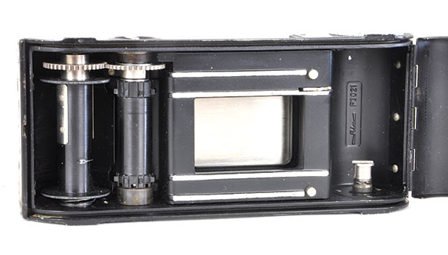

Slide 5
Film Cameras
Features:
High resolution
High dynamic range : ability to retain highlights
Work well even if the image is overexposed
Large sensor : shallow depth of field and small aperture
High sensitivity : smooth grain and noise effect

Slide 6

Mamiya film camera

Slide 7
Digital Cameras
Store images on a memory card
Features:
Low dynamic range : sensitive to exposure
Uses noise reduction
Autofocus
Depth of field can be infinitive : no bokeh and macro features
More customizable due to the availability of wide range of lenses (for high end DSLR cameras only)

Slide 8

Canon 5D + Helios 40-2 lens

Slide 9
Film vs digital
Film:
Pros : for high resolution images with a lot of textures (ex. Landscape pictures)
Cons :
Development process, such as scanning
Ongoing expense on film
Can’t view the picture immediately after taking it

Slide 10
Film vs digital
Digital:
Pros
Compact
Can view images right after taking it
Can be transferred to the computer easily
More customizable due to the availability of wide range of lenses
Cons :
Good cameras are expensive

